Slide 1
Coastal Landscapes
Chapter
11
Learning outcomes: 1.5, 2.7, 2.8

Slide 2
At the end of this chapter, you will be able to:
11.1 Explain marine (coastal) processes.
11.2 Describe and explain the formation of at least one landform of coastal erosion.
11.3 Describe and explain the formation of at least one landform of coastal deposition.
11.4 Describe how people have interacted with and managed coasts.

Slide 3
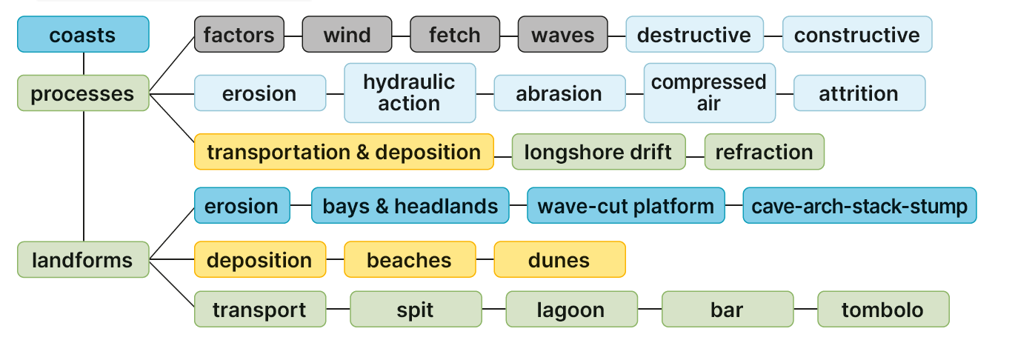
Keyword connections

Slide 4
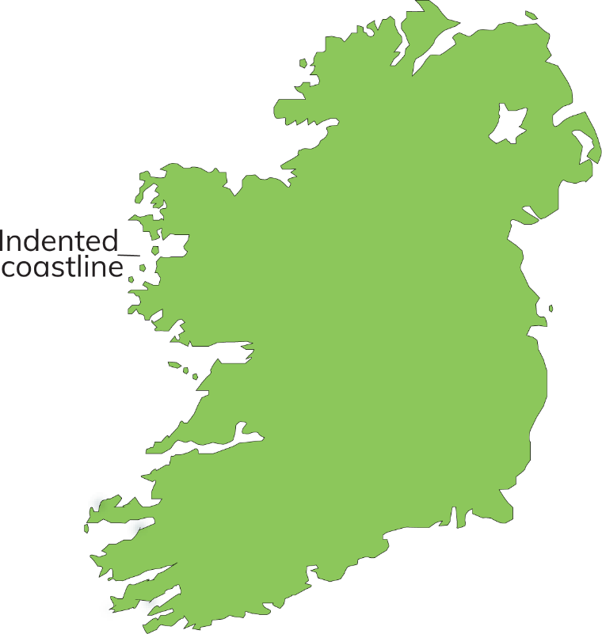
The Irish Coastline
When you look at a map of Ireland, you might notice that the east coast is relatively smooth, with few deep bays.
The west coast, however, is very indented, with lots of deep bays.
In a pair, think up as many reasons as you can to explain the difference between the two coastlines. Share your explanation in class.

Slide 5
11.1 Explain marine (coastal) processes.
Waves
Waves are formed by the wind moving across the surface of the sea. Waves cause erosion, transportation and deposition along our coastline. The power of waves depends on two things:
Wind speed
Fetch – the distance over which the wind blows.

Slide 6
11.1 Explain marine (coastal) processes.
Swash and backwash
Waves break when they reach shallow water at the shoreline.
The water that moves up the shore is called the swash.
The water that moves back down the shore is called the backwash.
The swash carries sediment up the shore and the backwash carries sediment back down the shore.

Slide 7
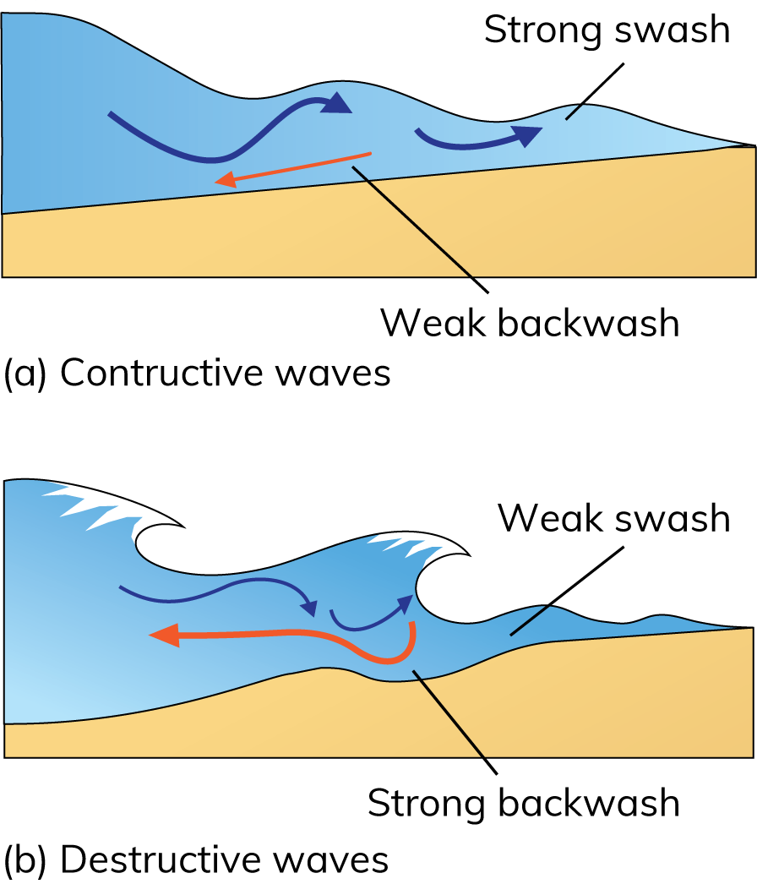
11.1 Explain marine (coastal) processes.
Types of Waves
1. Constructive waves
Strong swash and a weaker backwash.
Constructive waves deposit sediment on the shore.
Constructive waves happen in calm weather and during summer months when waves have less energy.

Slide 8
11.1 Explain marine (coastal) processes.
Types of Waves
2. Destructive waves
Weak swash and a stronger backwash.
Destructive waves erode sediment from the shore.
Destructive waves happen in poor weather and during winter months when waves have more energy.

Slide 9
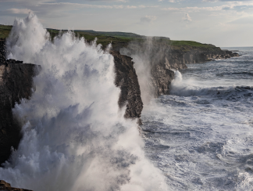
11.1 Explain marine (coastal) processes.
Erosion processes
Hydraulic action – the sheer force of waves removes rock and sand from the coastline.
Compressed air – Incoming waves compress air in the joints. When the wave retreats, the air expands. Over time, this pressure shatters the rock.

Slide 10
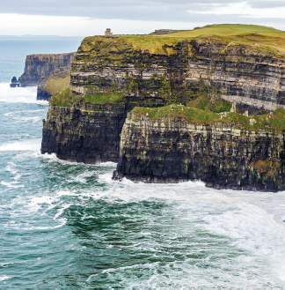
11.1 Explain marine (coastal) processes.
Erosion processes
Abrasion: Pebbles, stones and rocks are dashed against the coast by waves. This breaks off pieces of rock from the coastline.
Attrition: Pebbles and stones become rounded and worn down by rubbing against each other in the sea. Eventually the rocks are broken down into fine sand.
Solution: Sea water, which contains salt, gradually dissolves rock on the coastline.

Slide 11
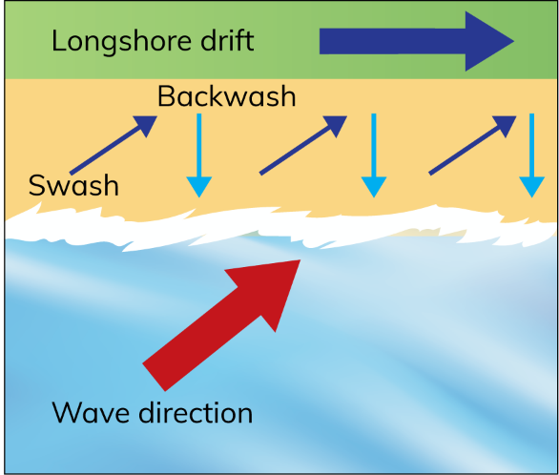
11.1 Explain marine (coastal) processes.
Transportation processes: longshore drift
When waves approach the shore at an angle, sediment is moved along the shore. This is known as longshore drift.
Waves break on the shore and the swash carries the sediment up the shore at an angle.
The backwash carries some of the sediment back down the beach at a right angle.
Over time, the zigzag movement of the swash and backwash causes sand and shingle to move along the length of the shore.

Slide 12

11.1 Explain marine (coastal) processes.
1. What does the word ‘marine’ mean?
2. What is the difference between constructive and destructive waves?
3. How does compressed air operate (work) when eroding a coastline?
4. What is longshore drift?
5. What causes deposition on a coastline?

Slide 13
11.1 Explain marine (coastal) processes.
Higher-order questions 1
1. How would Ireland’s west coast be affected by sea level rises?
2. How would faster wind speeds affect coastal erosion processes?
3. What happens to longshore drift if there is a change in the direction of a coastline?

Slide 14
11.1 Explain marine (coastal) processes.
Go to Section 11.1 on page 57 of your Skills Book.

Slide 15
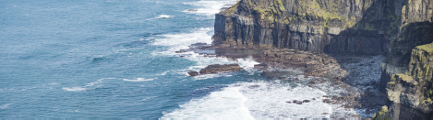
11.2 Describe and explain the formation of at least one landform of coastal erosion.
Cliffs and wave-cut platforms

Slide 16
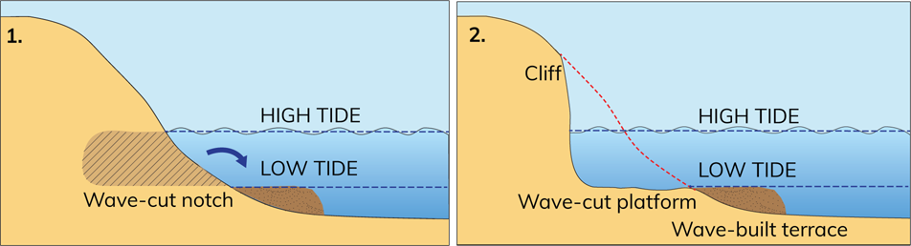
11.2 Describe and explain the formation of at least one landform of coastal erosion.
Cliffs and wave-cut platforms

Slide 17
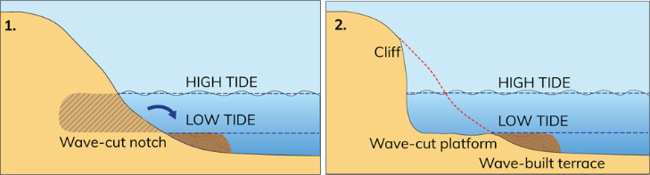
11.2 Describe and explain the formation of at least one landform of coastal erosion.
Cliffs and wave-cut platforms
Feature
Steep or vertical slope on the coast
Feature of erosion
Explanation
Destructive waves erode the coast.
At high tide, hydraulic action, compressed air and abrasion erode a wave-cut notch.
A wave-cut platform develops at the base of the cliff.
Sediment is transported and deposited below low tide.
This forms a wave-built terrace.
Over time, erosion enlarges the notch.
The rocks above the notch are undermined.
These rocks eventually collapse and a cliff is formed.
Examples:
The Cliffs of Moher, Co. Clare, and Slieve League, Co. Donegal – Ireland’s highest cliffs.

Slide 18
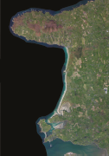
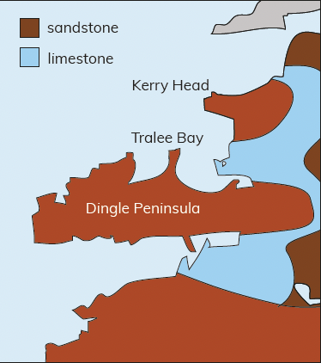
11.2 Describe and explain the formation of at least one landform of coastal erosion.
Tralee Bay

Slide 19
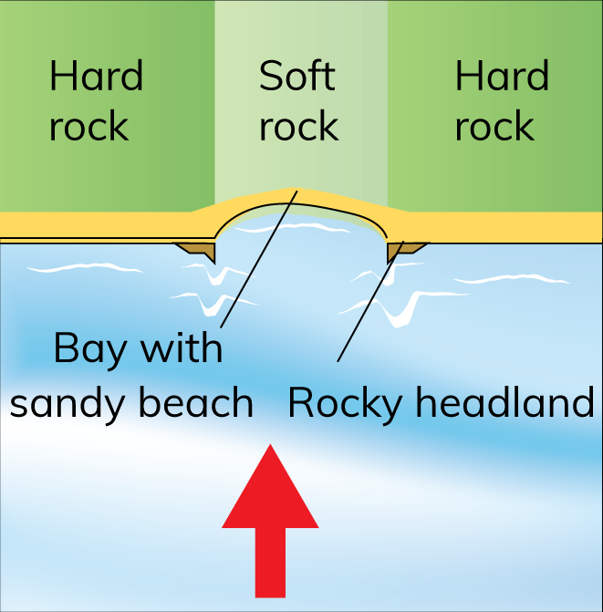
11.2 Describe and explain the formation of at least one landform of coastal erosion.
Bays and Headlands
Feature
Area of hard rock that juts out into the sea
Bay – an inlet eroded between two headlands
Bays and headlands – features of erosion
Explanation
They form in areas with soft rock and hard rock facing the sea.
The soft rock is eroded quickly by hydraulic action and abrasion.
This leaves an indent in the coast known as a bay.
The hard rock is left jutting out into the sea as a headland.
Examples
Tralee Bay, Co. Kerry, which is formed from limestone. To the south is the Dingle Peninsula and to the north is Kerry Head, both made of sandstone.

Slide 20
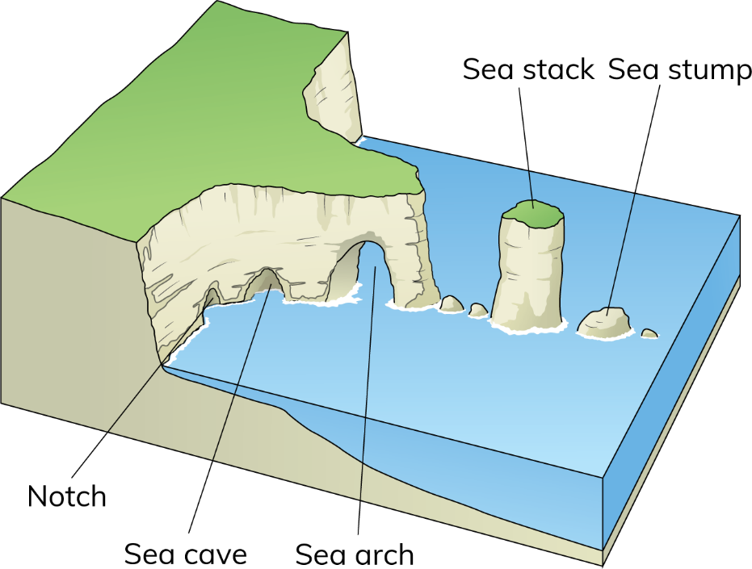
11.2 Describe and explain the formation of at least one landform of coastal erosion.
Sea Caves, Arches, Stacks, and Sea Stumps

Slide 21

11.2 Describe and explain the formation of at least one landform of coastal erosion.
Sea Caves, Arches, Stacks, and Sea Stumps
Feature
Found on rocky coastlines
Form where headlands have been eroded over a long period of time
Features of coastal erosion
Explanation
This is a wave-cut notch that is eroded at the base of a cliff.
Erosion forms a wave-cut notch at high tide.
Over time, the notch eventually develops into a sea cave.
Erosion eventually cuts through to the other side of the headland. This forms a sea arch.
When the roof of a sea arch collapses, a sea stack is formed.
The sea stack is isolated from the headland.
Over time, the sea stack will erode and form a sea stump.
Examples:
Great Pollet sea arch, Co. Donegal, and Dún Briste sea stack at Downpatrick Head in Co. Mayo.

Slide 22
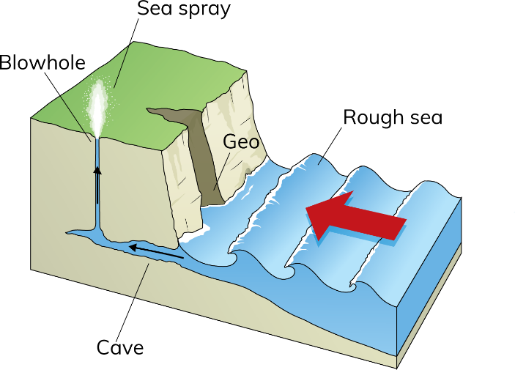
11.2 Describe and explain the formation of at least one landform of coastal erosion.
Blowhole
Feature
Shaft that goes through the roof of a sea cave to the land surface above
Found on rocky coastlines
Feature of erosion
Explanation
Waves force air into the back of sea cave.
Air becomes trapped and compressed.
This causes pressure to build up.
When the wave retreats, the air is released.
The air expands, causing the rock to shatter.
Over time, a hole forms in the roof of the cave.
Seawater sprays out of the hole during stormy weather.
Examples:
McSwyne’s Gun, Co. Donegal, and Downpatrick Head in north Co. Mayo.

Slide 23
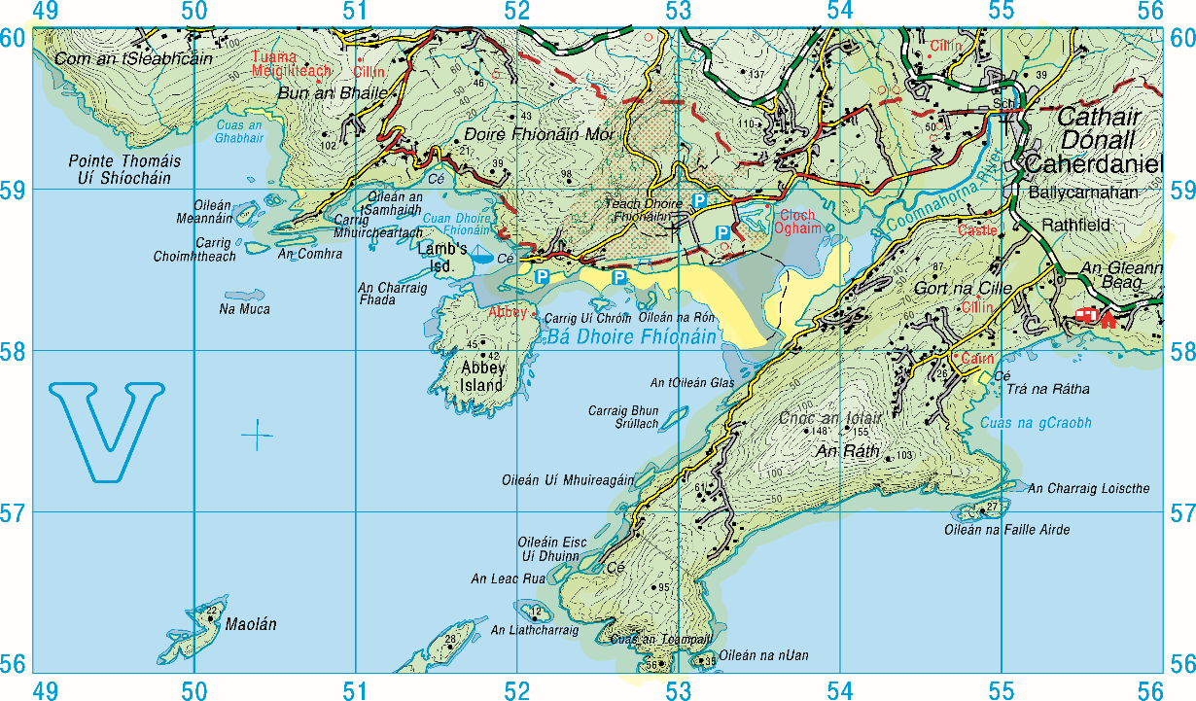
11.2 Describe and explain the formation of at least one landform of coastal erosion.
Identifying coastal erosion on an OS map

Slide 24

11.2 Describe and explain the formation of at least one landform of coastal erosion.
1. What is a cliff?
2. Why do bays and headlands form?
3. Put these features in order of formation: sea stump, wave-cut notch, sea stack, sea arch, sea cave.
4. Give a grid reference for the sea stack in Figure 11.15.
5. Name one well-known cliff and one well-known sea stack in Ireland.

Slide 25
11.2 Describe and explain the formation of at least one landform of coastal erosion.
Higher-order questions 2
1. Will cliffs keep eroding inland until all the land is gone?
2. Look at the map of Ireland on page 127 of your Textbook. What can you say about the rocks on the west coast of Ireland? When you have an answer for this, look at the map on page 46 of your Textbook.
3. Do some rock types on a coast erode more quicky than others? Explain your answer.

Slide 26
11.2 Describe and explain the formation of at least one landform of coastal erosion.
Go to Section 11.2 on page 59 of your Skills Book.

Slide 27
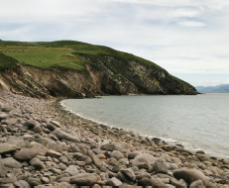
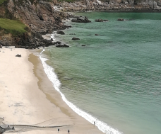
11.3 Describe and explain the formation of at least one landform of coastal deposition.
Beaches

Slide 28
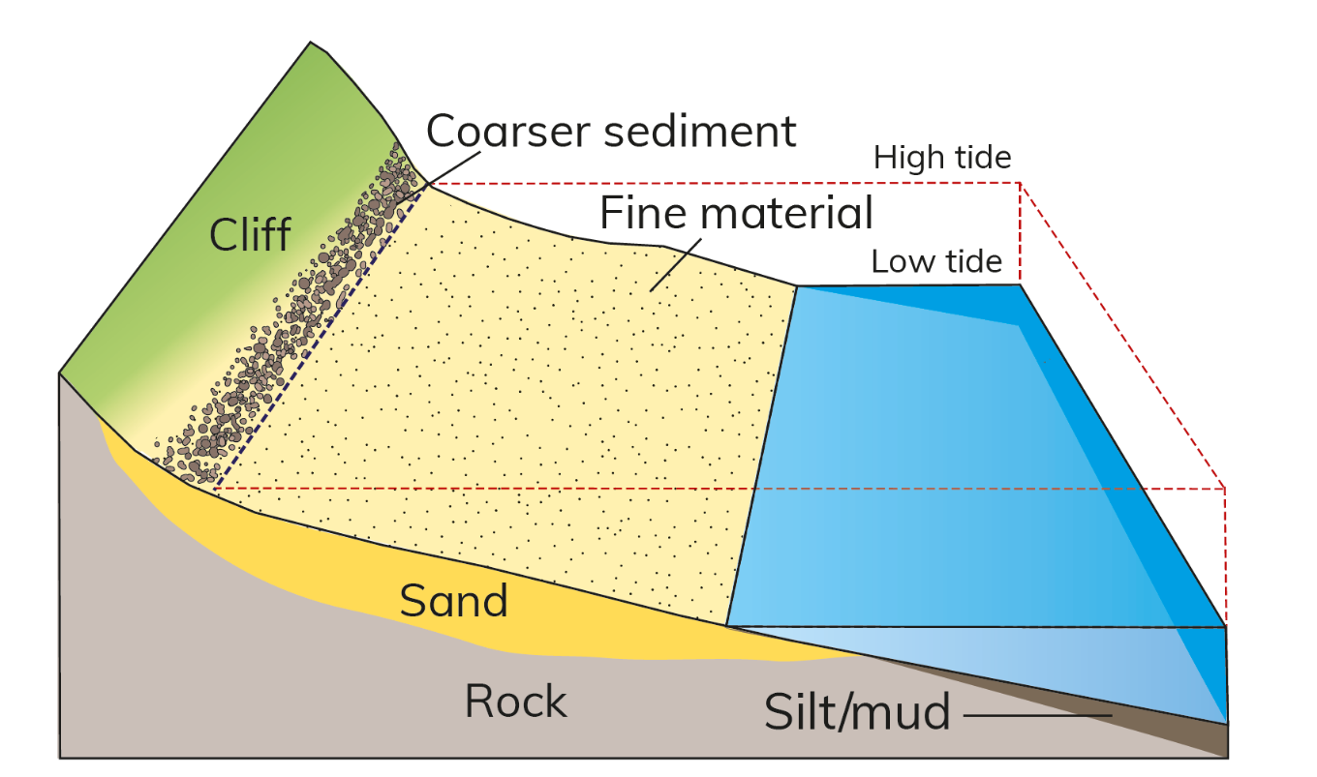
11.3 Describe and explain the formation of at least one landform of coastal deposition.
Beaches

Slide 29

11.3 Describe and explain the formation of at least one landform of coastal deposition.
Beaches
Feature
Gently sloping area of loose sand and shingle on a coastline
Form between high tide and low tide
Formed by deposition
Explanation
The swash carries sand and shingle up the shore.
The load is deposited.
The backwash carries only finer sediment (sand) down the shore.
Over time, this material builds up to form a beach.
Coarse sediment is found at the backshore.
Fine material is found at the foreshore.
Sometimes a storm beach forms during extreme weather.
Powerful waves throw boulders above the high tide mark.
Examples:
Sand beach at Ballybunion, Co. Kerry, and shingle beach at Shanganagh, Shankill, Co. Dublin.

Slide 30
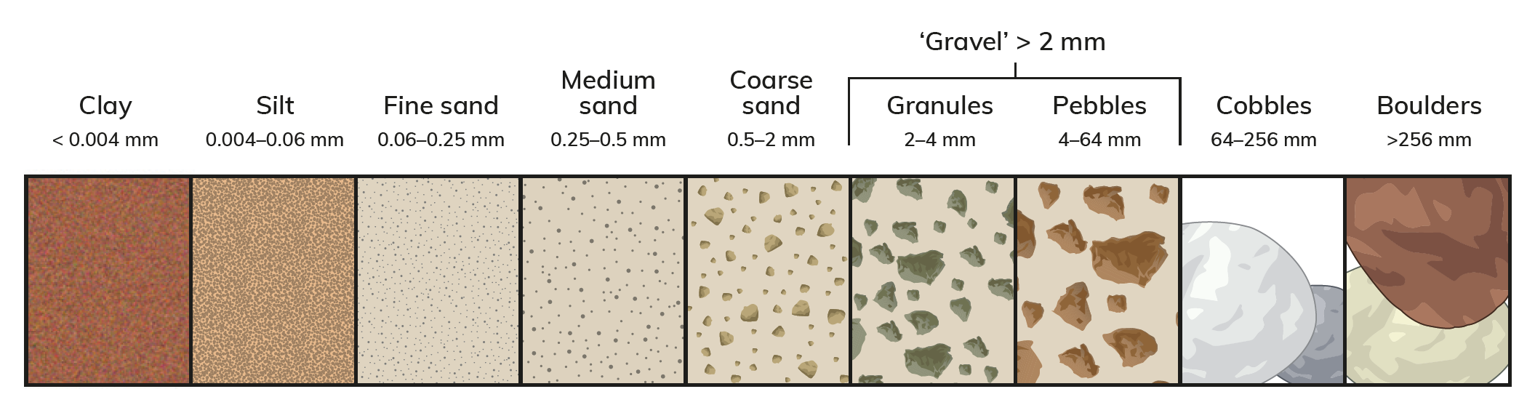
11.3 Describe and explain the formation of at least one landform of coastal deposition.
Names and sizes of different sediments found on a beach.

Slide 31
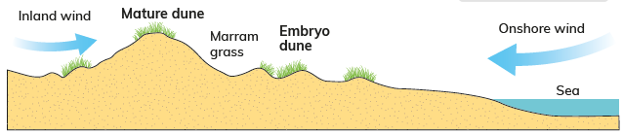
11.3 Describe and explain the formation of at least one landform of coastal deposition.
Sand Dunes
Feature
Large mounds of sand deposited at the back of a beach, beyond the high tide mark
Explanation
Sand on a beach is dried by onshore winds.
The dry sand is lighter than the wet sand and blows inland.
Inland winds limit how far inland the sand blows.
The sand is trapped by marram grass.
Builds up to form sand dunes.
The marram grass helps bind the grains of sand together.
Examples: Rosslare, Co. Wexford, and Tramore, Co. Waterford.

Slide 32
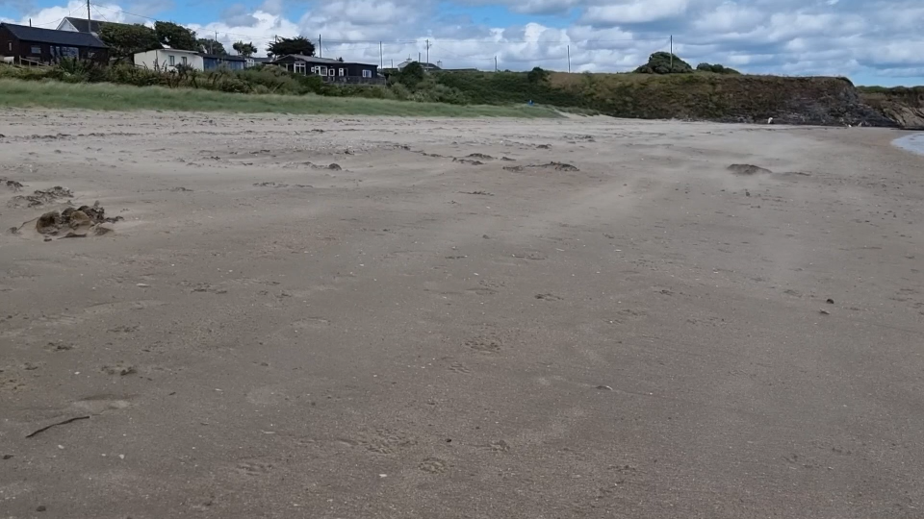
11.3 Describe and explain the formation of at least one landform of coastal deposition.
Sand Dunes
Sand blowing on a beach at Rush, County Dublin

Slide 33
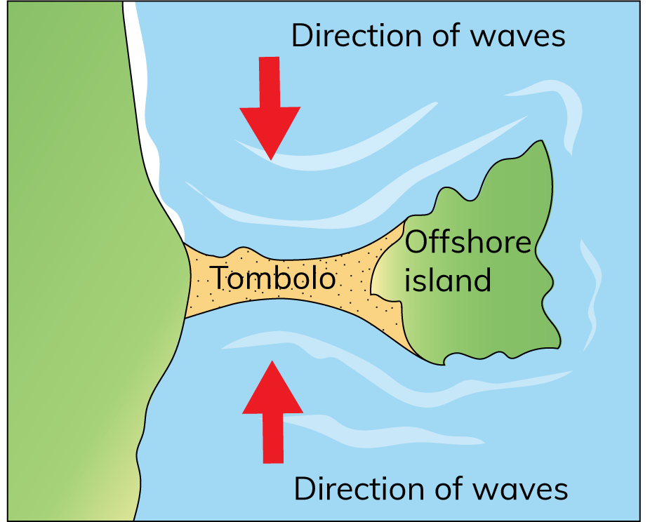
11.3 Describe and explain the formation of at least one landform of coastal deposition.
Tombolos
Feature
Narrow ridge of sand or shingle that joins an island to the mainland
Formed by deposition
Explanation
Tombolos form when waves approach an island from different directions.
As the waves meet, they cancel each other out and lose energy.
This causes deposition between the mainland and the island.
Over time, a long, narrow sand bar builds up, connecting the island to the mainland.
Example
Howth Head in Co. Dublin was once an island. Waves approaching from the north and from the south met at what is now Sutton.

Slide 34
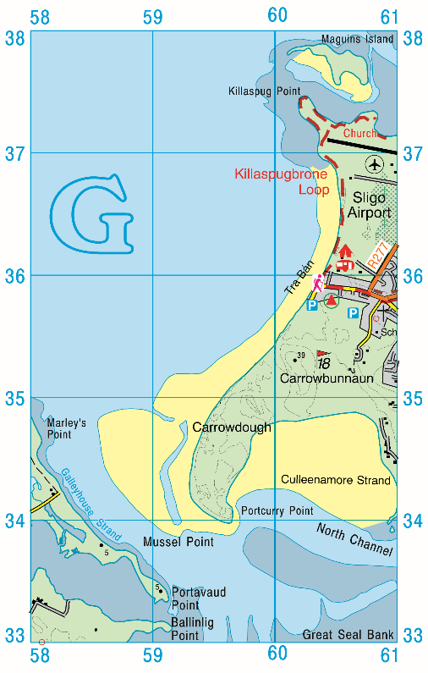
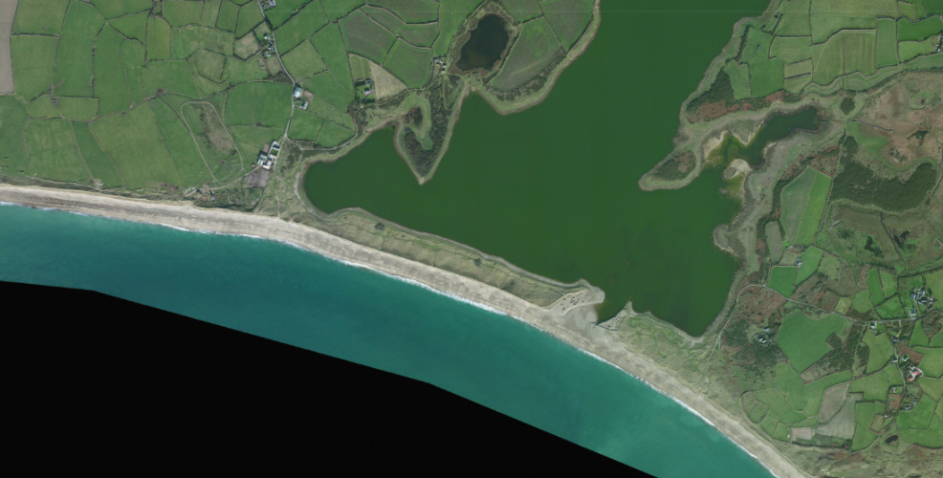
11.3 Describe and explain the formation of at least one landform of coastal deposition.
Spits and lagoons

Slide 35
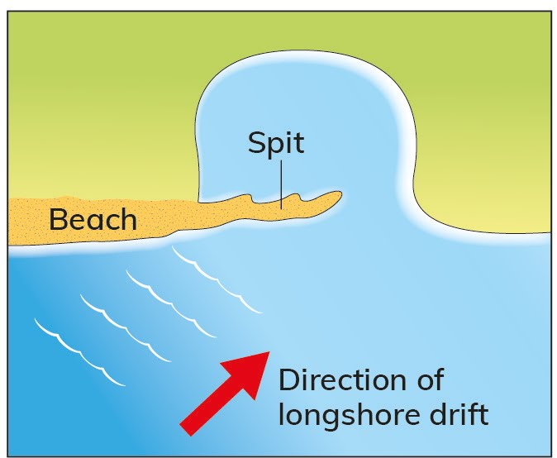
11.3 Describe and explain the formation of at least one landform of coastal deposition.
Spits and lagoons

Slide 36
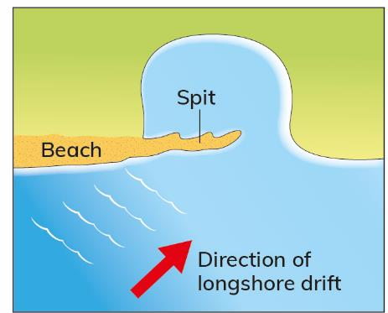
11.3 Describe and explain the formation of at least one landform of coastal deposition.
Spits and lagoons
Feature
Long, narrow beach of sand or shingle
Connected to the mainland at one end and extends across a bay
Formed by deposition
Explanation
Formed when longshore drift reaches a change in the direction of the coastline,
e.g. a bay
Longshore drift transports sand and shingle along the coast in a zigzag pattern.
At the change in the coastline, the waves lose energy and deposit sediment.
Over time, this material builds up and rises above sea level to form a sand spit
Wind and wave action can cause the sand spit to lengthen and curve inwards.
Over time, longshore drift will continue to move sediment along the coast.
The spit will develop into a sand bar, separating the bay from the sea.
This forms a salt lake called a lagoon.
Examples:
Donegal golf course in Co. Donegal is a sand spit. Lady’s Island Lake in Co. Wexford is a lagoon.

Slide 37

11.3 Describe and explain the formation of at least one landform of coastal deposition.
1. What is swash and backwash?
2. What process causes sand spits to form?
3. What is a lagoon?
4. How do tombolos form?
5. How are beaches shown on OS maps?

Slide 38
11.3 Describe and explain the formation of at least one landform of coastal deposition.
Higher-order questions 3
1. Why is marram grass important to sand dunes?
2. In Ireland, several spits are used for golf courses. Why is this?
3. How might climate change affect coastal deposition?

Slide 39
11.3 Describe and explain the formation of at least one landform of coastal deposition.
Go to Section 11.3 on page 60 of your Skills Book.

Slide 40
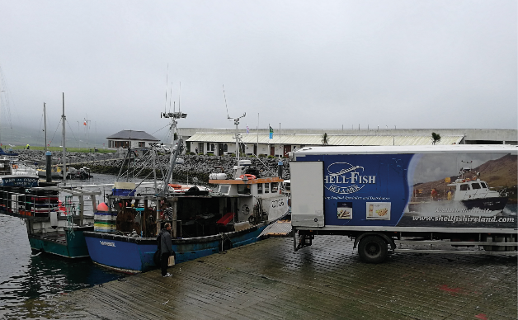
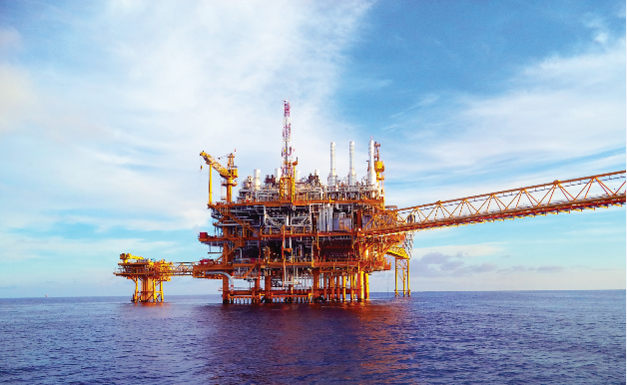
11.4 Describe how people have interacted with and managed coasts.
People use the sea in a many different ways.
Food and energy
The sea is an important source of food and energy.
Fishing and trawling provide food and create jobs, e.g. Killybegs, Co. Donegal.
Fish farming is a growing industry driven by the demand for fish.
Fish farming takes place in inlets.
Energy
Oil and gas found under the sea are extracted by offshore drilling, e.g. Corrib gas field, Co. Mayo.
Offshore wind farms are a source of renewable energy.
A new wind farm is being developed offshore near Arklow, Co. Wicklow.

Slide 41
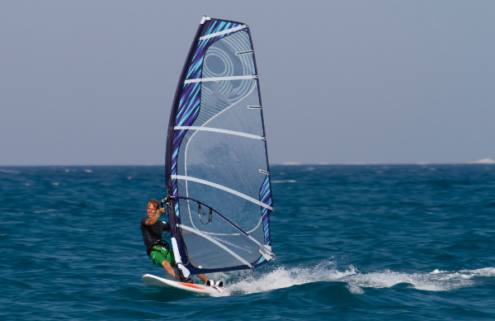
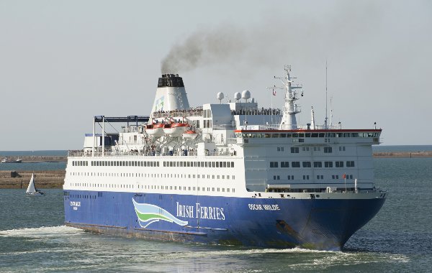
11.4 Describe how people have interacted with and managed coasts.
Tourism and recreation
Tourists like to visit coasts to swim and to enjoy sandy beaches.
People also use the sea for leisure activities such as watersports, fishing and sailing.
Examples of popular seaside towns include Rosslare, Co. Wexford and Kinsale, Co. Cork.
Transport
International trade depends on sea transport.
For example, 12 per cent of global trade is transported through the Suez Canal in Egypt.
In 2021, a container ship named the Ever Given blocked the Suez Canal for six days, at a cost of over $1 billion.

Slide 42
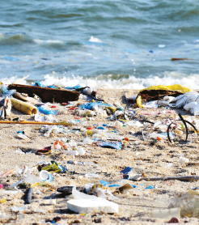
11.4 Describe how people have interacted with and managed coasts.
Environmental impacts of recreation
However, increasing numbers of visitors can damage the coastline.
Sand dunes
These can be damaged by people walking over marram grass that traps the sand.
The increased numbers of visitors to beaches means that more people are likely to walk on the dunes.
In an attempt to stop this, fences have been built around the sand dunes on Curracloe Beach in Co. Wexford.
Sewage
Waste water from homes and businesses is often piped into the sea.
If it is not treated properly, it can seriously damage fish life.
Litter
During the peak season of June, July and August, local councils find it difficult to keep beaches free from litter.

Slide 43
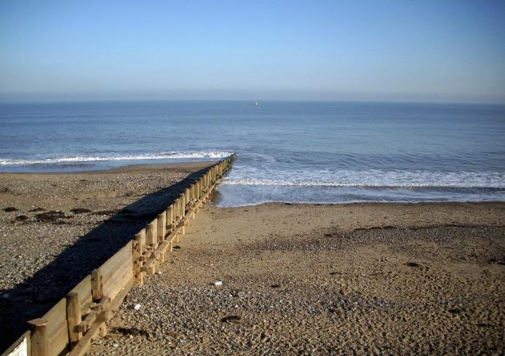
11.4 Describe how people have interacted with and managed coasts.
Local authorities use a number of hard-engineering solutions to protect beaches.
1. Groynes
Groynes are human-made concrete or wooden walls built at right angles to the sea and are used to prevent or slow down the process of longshore drift.
Groynes trap sediment and help to build up a beach in one area.
Unfortunately, the use of groynes also means that areas further along the coast receive little or no sand from the process of longshore drift.
In this way, groynes also can cause coastal erosion.
Example:
Rosslare, Co. Wexford

Slide 44
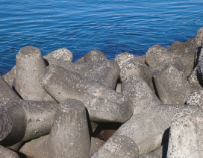
11.4 Describe how people have interacted with and managed coasts.
2. Rock armour/boulders
Rock armour is large boulders placed at the base of cliffs or sand dunes to reduce the erosive power of the waves.
When the waves hit the boulders, much of their energy is used up, which prevents erosion.
Example:
Rosslare, Co. Wexford
Local authorities use a number of hard-engineering solutions to protect beaches. These include the following.
1. Groynes
Example: Rosslare, Co. Wexford
Groynes are human-made concrete or wooden walls built at right angles to the sea and are used to prevent or slow down the process of longshore drift. Groynes trap sediment and help to build up a beach in one area. Unfortunately, the use of groynes also means that areas further along the coast receive little or no sand from the process of longshore drift. In this way, groynes also can cause coastal erosion.
2. Rock armour/boulders
Example: Rosslare, Co. Wexford
Rock armour is large boulders placed at the base of cliffs or sand dunes to reduce the erosive power of the waves. When the waves hit the boulders, much of their energy is used up, which prevents erosion.

Slide 45
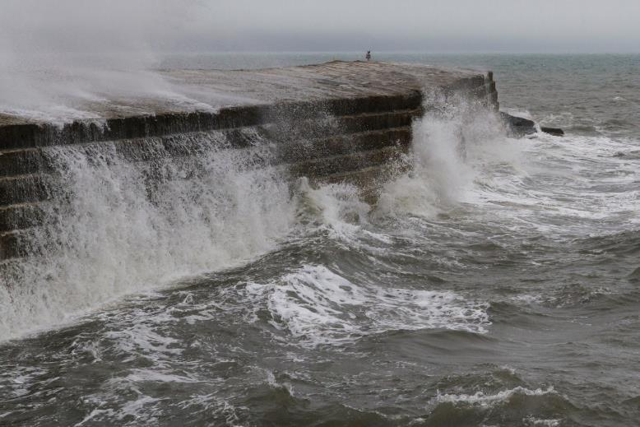
11.4 Describe how people have interacted with and managed coasts.
3. Sea walls
Sea walls are built at the back of beaches to protect coastal towns or areas of high economic value from the sea.
The walls are usually sloped and curved at the top.
This forces the wave to break back on the next incoming wave, thus reducing its power.
Example:
Tramore, Co. Waterford

Slide 46
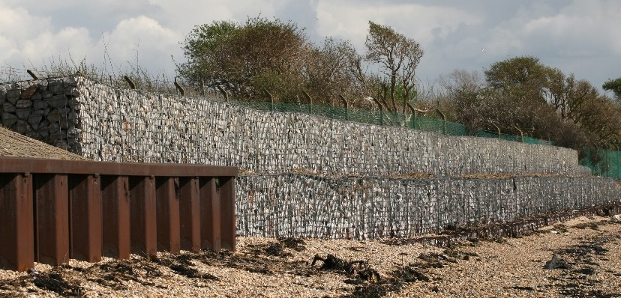
11.4 Describe how people have interacted with and managed coasts.
4. Gabions
Gabions are wired cages that contain stones.
They absorb the energy and reduce the erosive power of the incoming waves.
They are placed in front of sand dunes or at the back of a beach.
Example:
Courtown, Co. Wexford

Slide 47
11.4 Describe how people have interacted with and managed coasts.
Complete the Exam Expert on page 137 of your Textbook.

Slide 48

11.4 Describe how people have interacted with and managed coasts.
1. Name four ways people use coastal environments.
2. List three impacts of recreation on coasts.
3. Name four coastal defence measures.
4. Why is longshore drift a threat to beaches?
5. How do groynes prevent erosion?

Slide 49
11.4 Describe how people have interacted with and managed coasts.
Higher-order questions 4
1. What steps could county councils take if they wanted to encourage deposition along a coastline?
Which coastal defence measures are best suited to each of the following? Sand beach with longshore drift Sand and shingle beach that is exposed to storms Harbour that silts up regularly
3. What actions can we take as individuals to keep beaches clean?

Slide 50

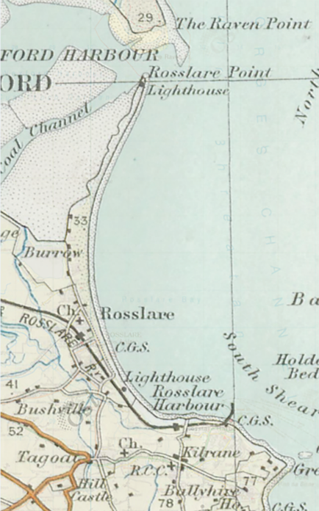
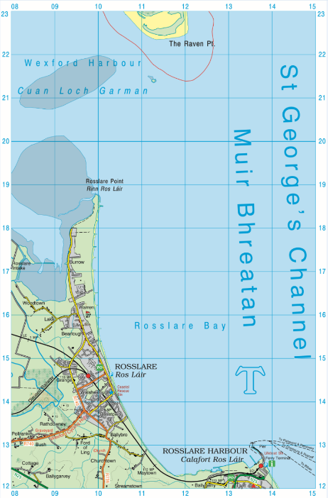
11.4 Describe how people have interacted with and managed coasts.
Coastal Protection at Rosslare
Activity
In a pair, examine the maps opposite.
Identify the changes in the coastline between the two maps.
Explain why you think these changes have occurred.
What coastal processes are involved?

Slide 51
11.4 Describe how people have interacted with and managed coasts.
Coastal Protection at Rosslare
In 1867, a pier for ships was constructed at Rosslare Harbour (OS Map: Figure 11.30, page 139, T 138 126).
The port became busier over time.
The pier was replaced with an impermeable sea wall in 1978 (OS Map: Figure 11.30, page 139, T 135 139).
The wall affected longshore drift and deposition.
When waves reach the wall, they slow down and deposit material.
Sand that was being moved north along the coast was trapped by the wall and deposited south of the harbour.

Slide 52
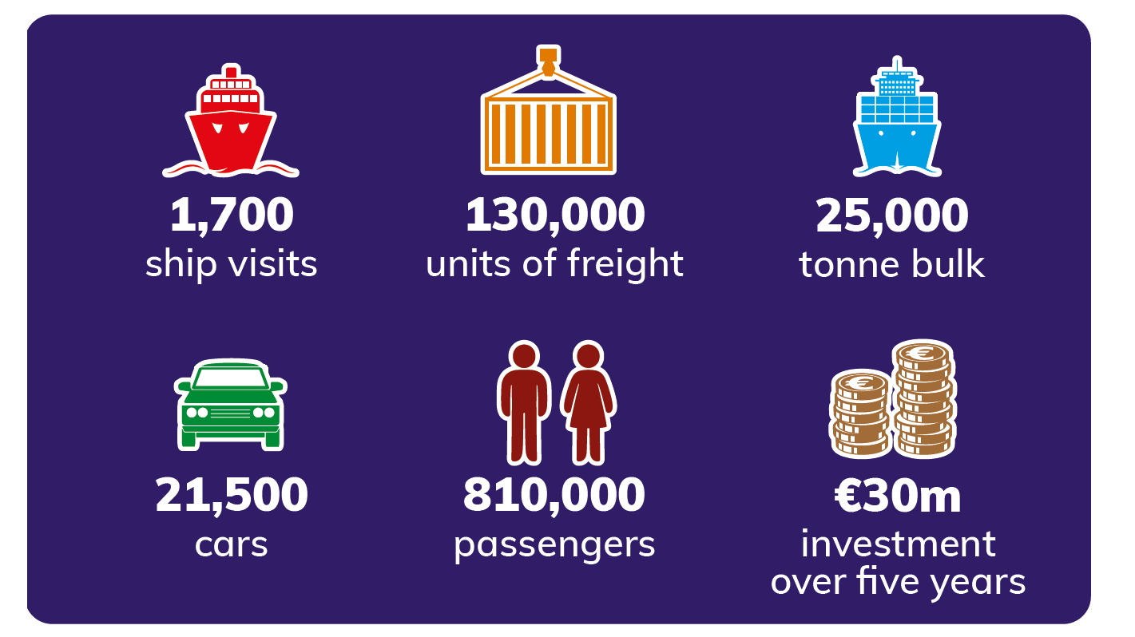
11.4 Describe how people have interacted with and managed coasts.
Economic impact of the sea wall
It allowed the port of Rosslare to become busier over time.
Road and rail connections in Rosslare allowed the port to grow as a result of trade with Britain.
Now Brexit has also increased the level of trade and transport through Rosslare from Europe.
Motorway and rail links connecting through the south-east and to Dublin are being modernised.
A masterplan worth €30 million is being put into action to develop the port.

Slide 53
11.4 Describe how people have interacted with and managed coasts.
Social impact of the sea wall
Rosslare Strand has been an important tourist location for over 100 years.
Tourism and the development of the port at Rosslare Harbour have attracted people to live and work in Rosslare.
As a result, Rosslare has grown in size and population over time.
This has increased the services and amenities in the area.

Slide 54
11.4 Describe how people have interacted with and managed coasts.
Environmental impact of the sea wall
The construction of the sea wall affected the sustainability of the beach all along Rosslare Strand and sand spit.
A new beach formed near the harbour.
This decreased the transport of sand along Rosslare Strand.
This resulted in erosion firstly of Rosslare sand spit and then of Rosslare Strand.
Flooding of a nearby golf course occurred. Action had to be taken to protect the remaining beach on Rosslare Strand.
Coastal defences at Rosslare Strand
Beginning in 1974, gabions, rock armour and groynes were placed along the coast to prevent erosion at Rosslare Strand.
Sand was taken from the seabed and was used to replace what was lost.
This is called beach nourishment.
Expensive ongoing work is needed to maintain Rosslare Strand.

Slide 55
11.4 Describe how people have interacted with and managed coasts.
Go to Section 11.4 on page 60 of your Skills Book.

Slide 56
Assess your progress
Go to page 63 of your Skills Book and assess your progress.
11.1 Explain marine (coastal) processes.
11.2 Describe and explain the formation of at least one landform of coastal erosion.
11.3 Describe and explain the formation of at least one landform of coastal deposition.
11.4 Describe how people have interacted with and managed coasts.
Identify any gaps in your learning. Use the Rapid Revision on page 141 of your Textbook to jog your memory.

